Slide 1

BIKE SHARING DEMAND ANALYSIS USING EXCEL
By Ajay Kumar Sahu
A PROJECT BY NEXTHIKES IT SOLUTIONS

Slide 2

Problem Statement:
Analysing Bike sharing data helps understand how weather, time, and holidays affect bike rentals. This project uses excel skill to clean, combine and study datasets to find useful patterns that improve business planning.

Slide 3
Project Overview:
Bike Sharing Demand Analysis Project Using Excel
In order to ascertain when and why individuals rent bikes, this research uses Excel to assess the demand for bike sharing. After being merged into a single sheet, all of the data from various sources was verified for accuracy. To distinguish between weekdays and weekends, time of day, and total users, new columns were added. Patterns in rents by weather, time, and user type were discovered using pivot tables, algorithms, and charts. The project assists in demonstrating the busiest hours, the impact of weather on demand, and the distinctions between casual and registered users. Planning and decision-making in bike-sharing systems can be enhanced by the knowledge gained from this investigation.

Slide 4
Data Descriptions:
The bike sharing data contains information about like rental from 01st Jan to 14th Feb 2011.
It contains observations of 24 columns such as date, time, day, holiday, number of bikes rented (casual, registered, count), weather conditions (temp, humidity, windspeed) and other derived factors that may influence bike rental demand.
The dataset contains 1001 rows and 24 columns.

Slide 5
Bike Rental Factors that make it popular are:
Faster way to communicate in cities with high traffic volumes.
Easy access.
Cheaper than automobiles services.
Environment friendly free from pollution and no carbon footprint.
Promote physical action and exercise.

Slide 6
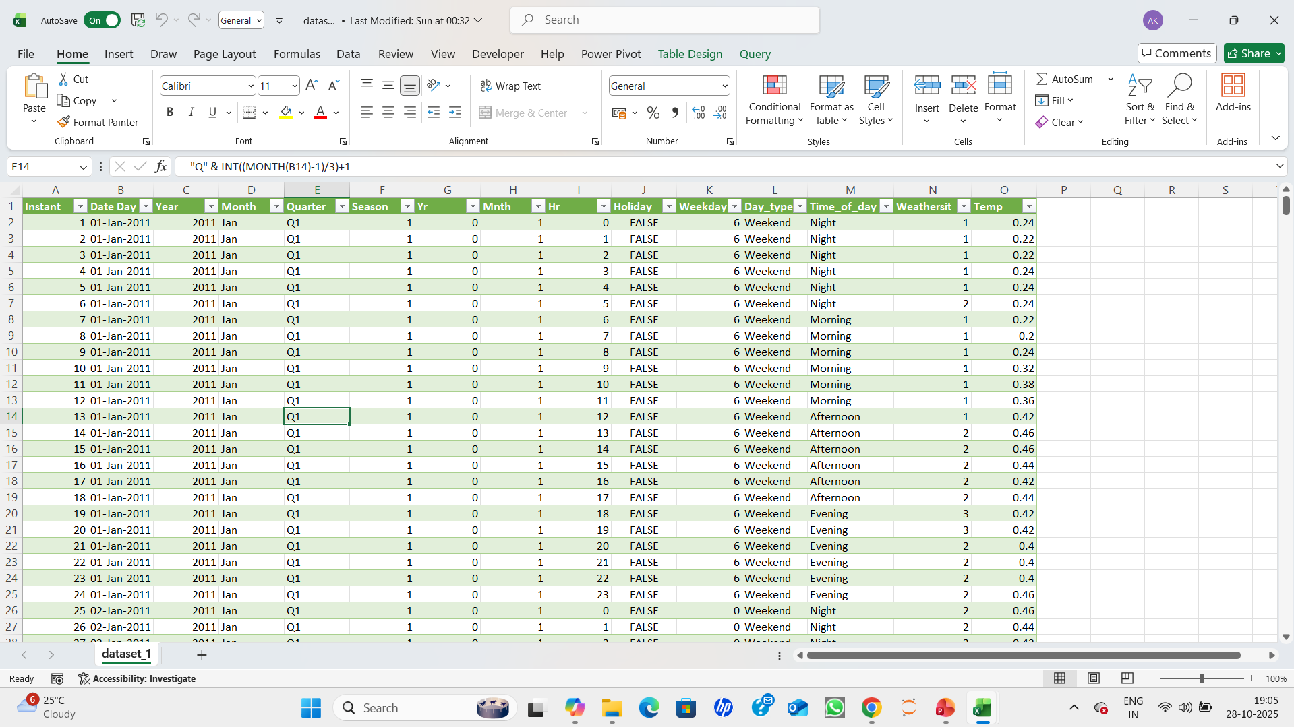
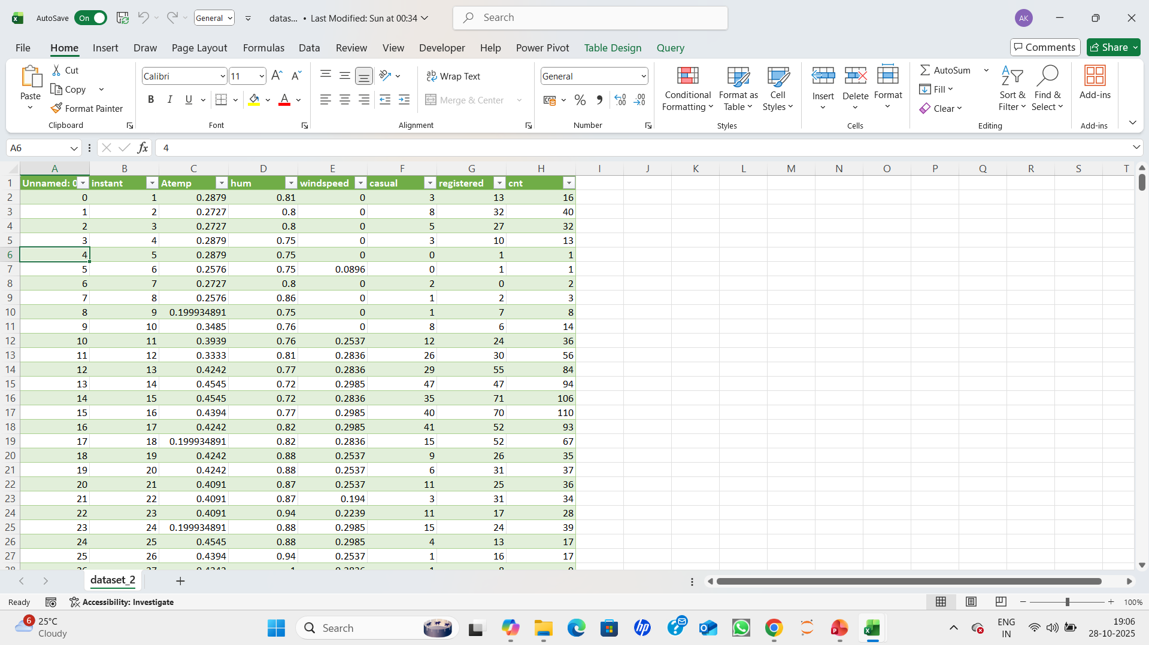
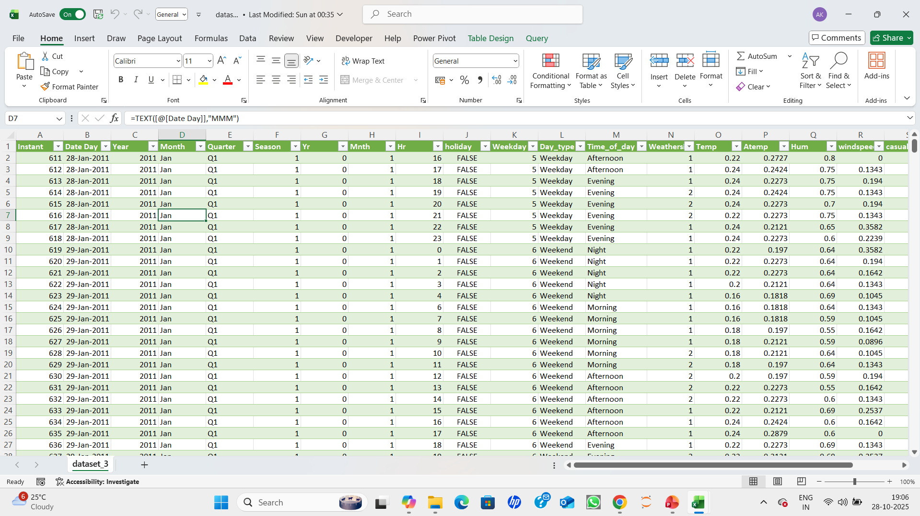
Step-1: Load and Inspect data.
Open all three datasets (dataset_1.xlsx,dataset_2.xlsx,dataset_2.xlsx) in Excel.
Check for missing values, Inconsistent column names and data types.

Slide 7
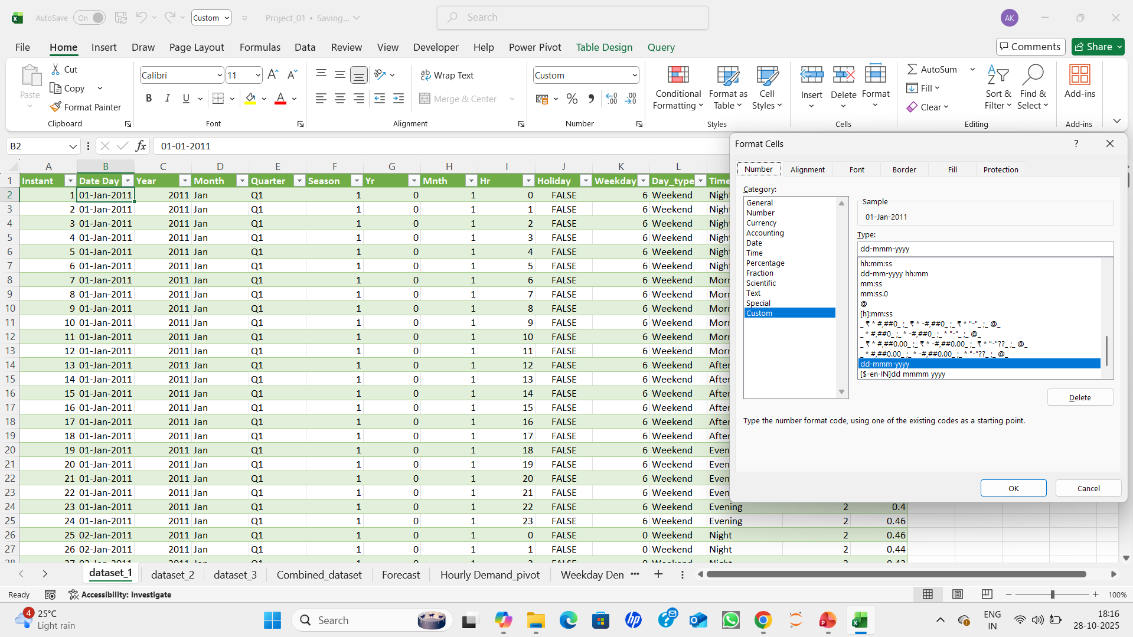
ii. In this one we are doing the fixing the data types, changing the date format, trimming the spaces and repeat all the same process in other data sheets as well.

Slide 8
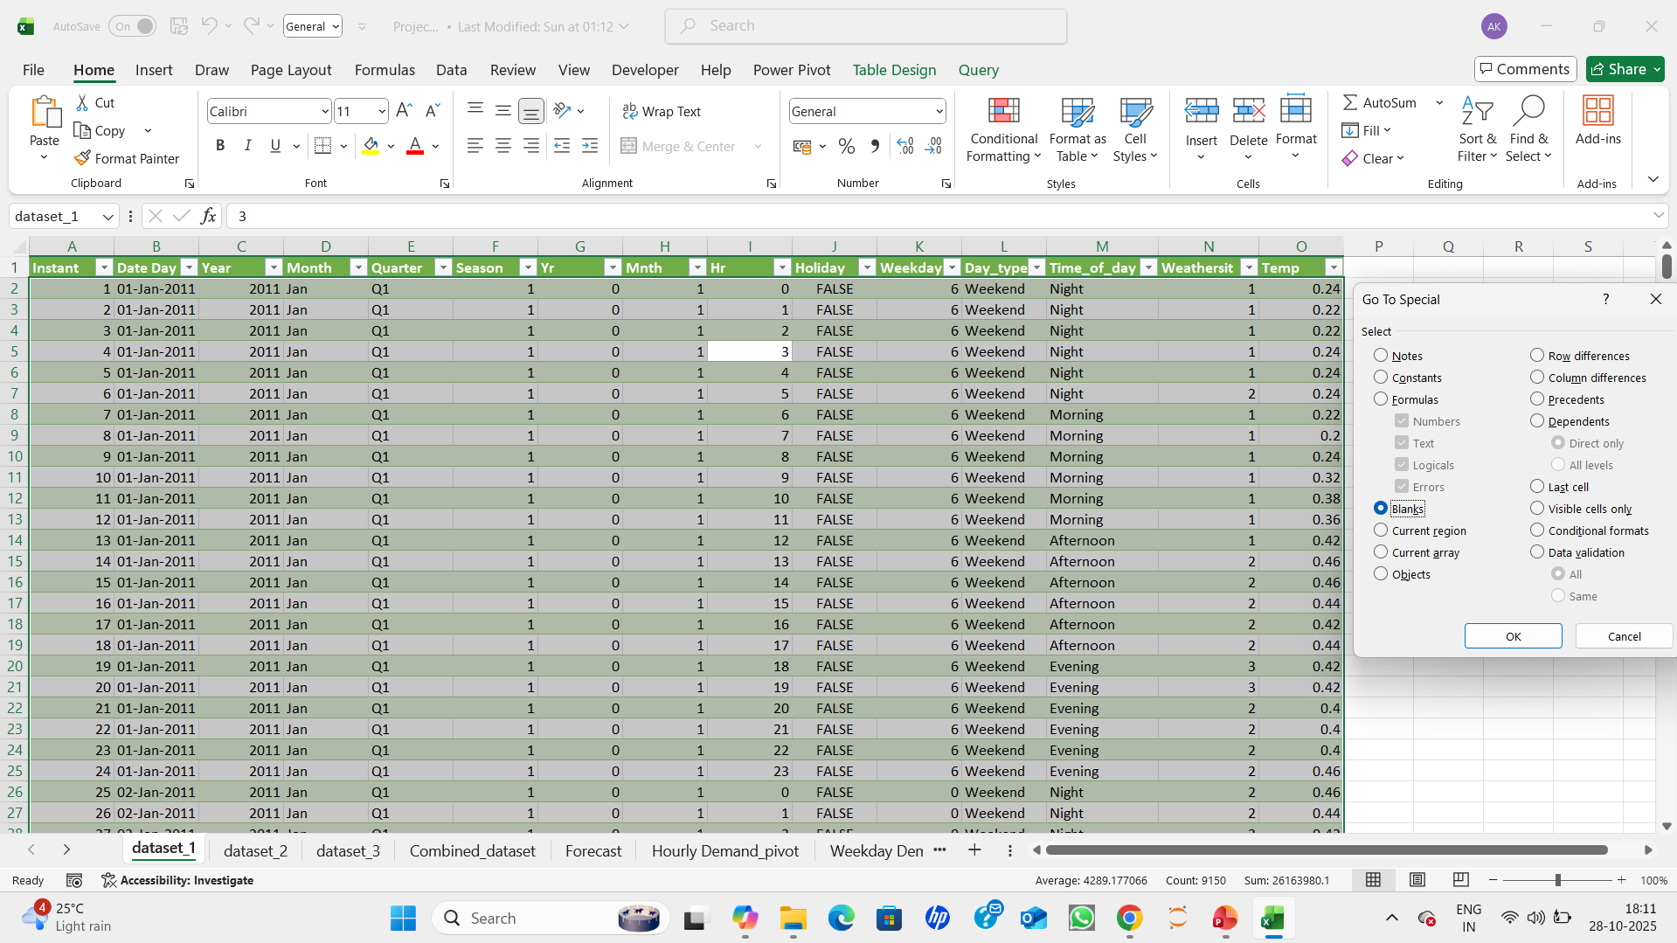
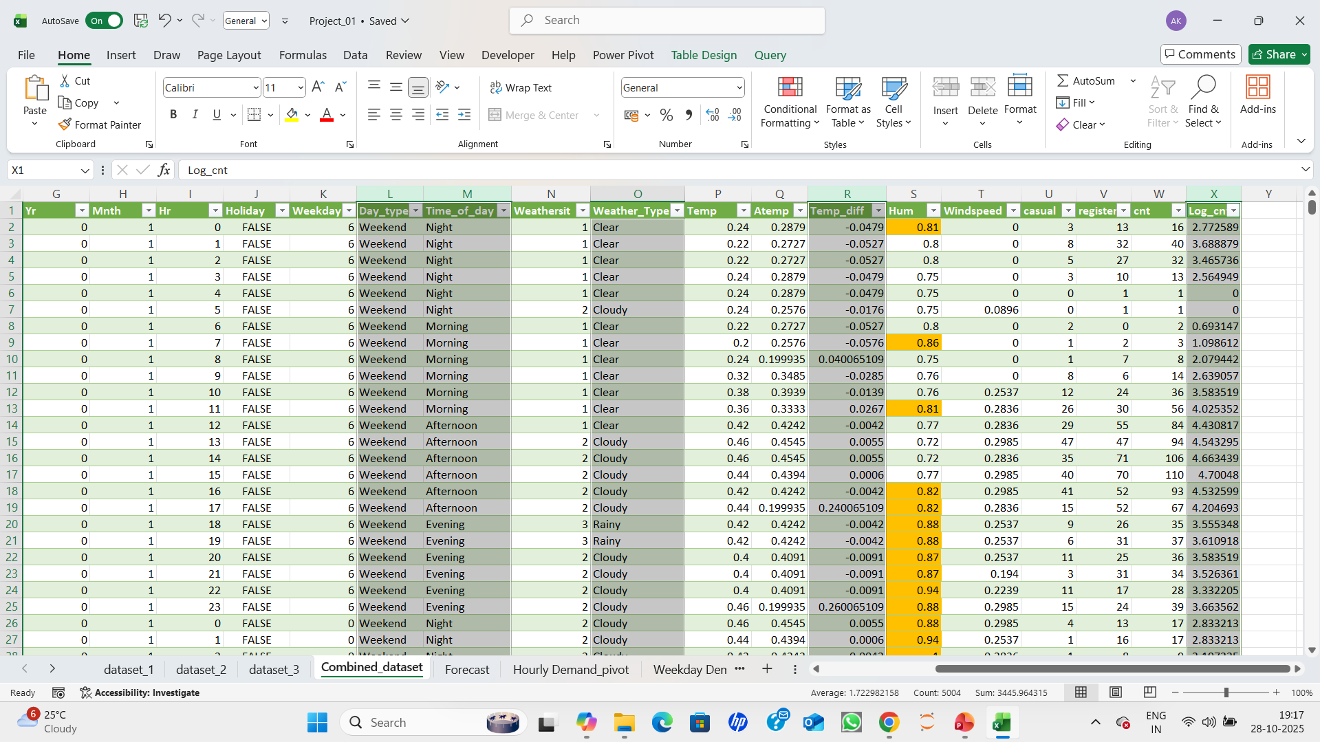
Step-2: Upload the all 3 datasheets into one workbook and do the preprocessing in all sheets one by one.
After the data has been uploaded, preprocess each datasheet individually. This includes handle (fill or drop) missing values using mean/median imputation, eliminating duplicate values and adding columns.
Add new columns:
Year: YEAR([@[Date Day]])
Month: TEXT([@[Date Day]],"MMM")
Quarter: ="Q" & INT((MONTH(B2)-1)/3)+1
Day_type : IF(OR(K2=0,K2=6),"Weekend","Weekday")
Time_of_day : IFS(I2<6,"Night", I2<12,"Morning", I2<18,"Afternoon", TRUE,"Evening")
Temp_diff: [@Temp]-[@Atemp]
Weather_Type: IF([@Weathersit]=1,"Clear",IF([@Weathersit]=2,"Cloudy","Rainy"))
Log_cnt: IF([@cnt]>0,LN([@cnt]),0)

Slide 9
Step 3: After done with preprocessing now will merge dataset_1 and dataset_2.
🔗 Steps to Merge Dataset_1 and Dataset_2 using excel formulas:
Using VLOOKUP:
In dataset_1, add columns to pull data from dataset_2 and dataset_3.
A2: the instant value in dataset_1.
dataset_2!B1:H611: range in dataset_2
2: column number to return (e.g., atemp)
False: exact match
Repeat for other columns like hum, windspeed, Casual, registered, cnt.

Slide 10
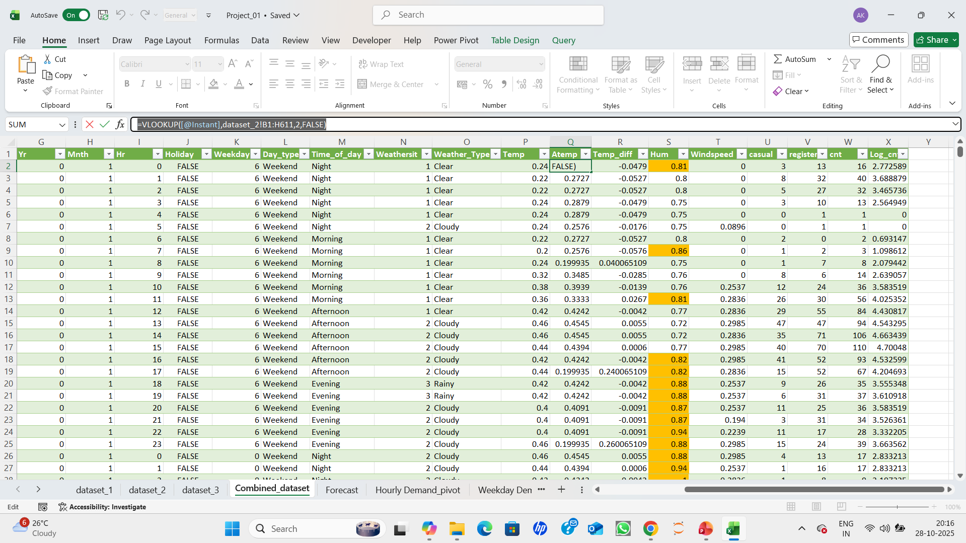
After merged dataset_1 and dataset_2:
Steps to Append new merged dataset_1&2 and dataset_3:
Manual Append (Best for Small Data)
✅ Step-by-Step:
Open a new sheet called Combined_Data.
Copy all rows from merged dataset_1&2 (excluding headers) and paste into Combined_Data starting at row 2.
Copy rows from dataset_3 and paste below the last row of merged dataset_1&2.
💡 Tip: Use Ctrl + Shift + ↓ to select all rows quickly

Slide 11
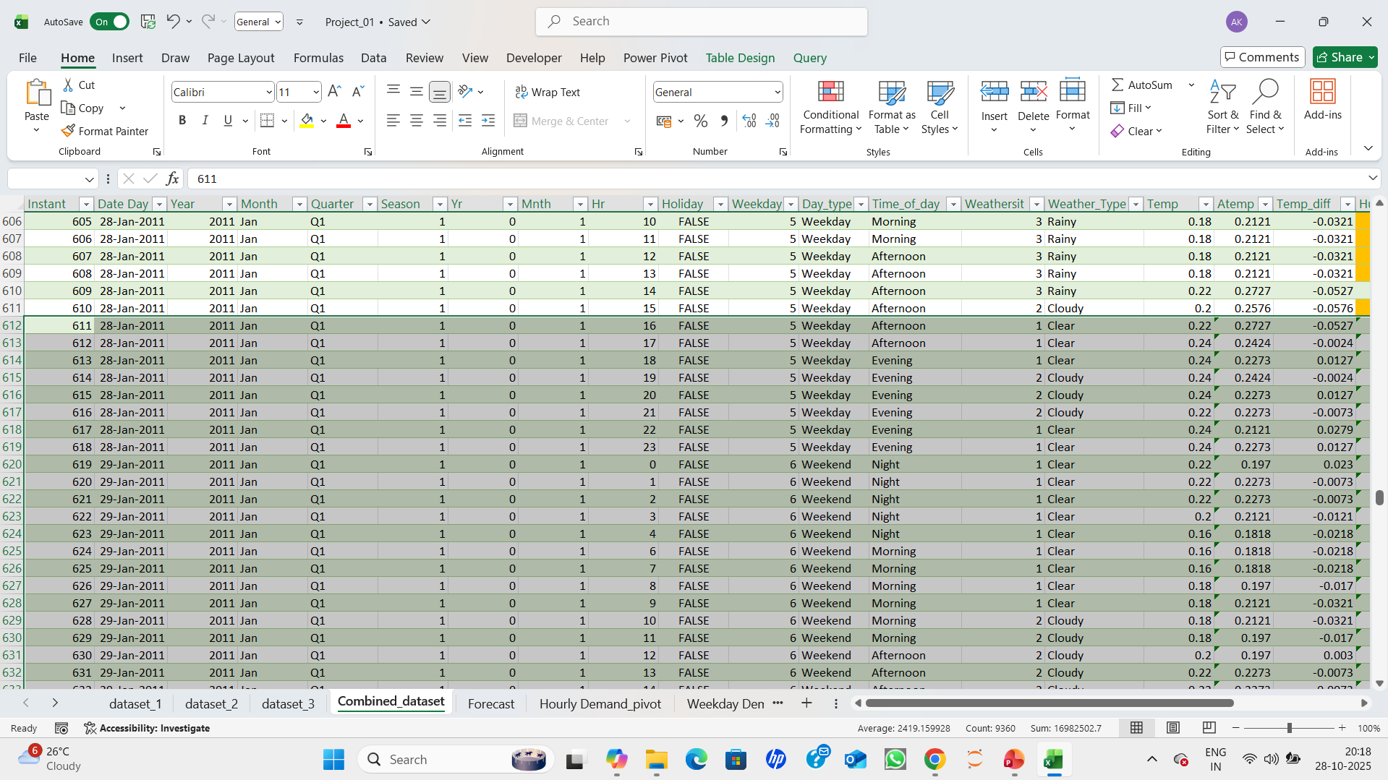
Step 4: Highlight Extreme Weather:
✅: Select the Data Range
Click and drag to select all rows of the dataset — for example A2:X1001 (or whatever range includes hum and windspeed)
Open Conditional Formatting:
Go to the Home tab
Click Conditional Formatting
Choose “Use a Formula”
In the New Formatting Rule window, select: “Use a formula to determine which cells to format
Enter the Formula: Assuming
Hum is in column S and Windspeed is in column T =OR(S2>0.8, T2>0.4)
Click format- choose fill color(e.g.,orange)-click OK
Click OK again to apply the rule and now rows with extreme weather will be highlighted in Orange.

Slide 12
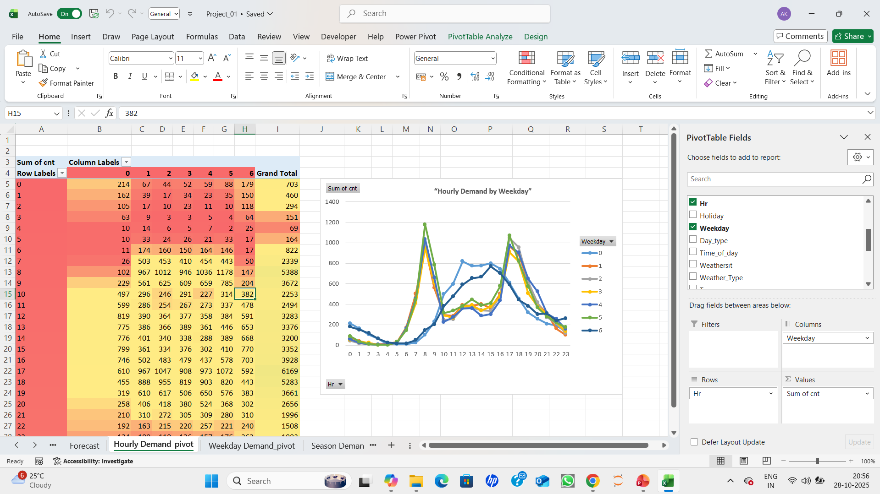
Step 5: Now Insert a Pivot Table : Go to insert > PivotTable Select the table as source Choose new worksheet named as “Hourly Demand"- click OK Drag Hr to Rows. Drag Weekday to Columns Drag cnt to Values. By default, Values shows Sum of cnt → that’s total rentals by hour
Add a Line chart to shows hourly trends across weekdays.

Slide 13
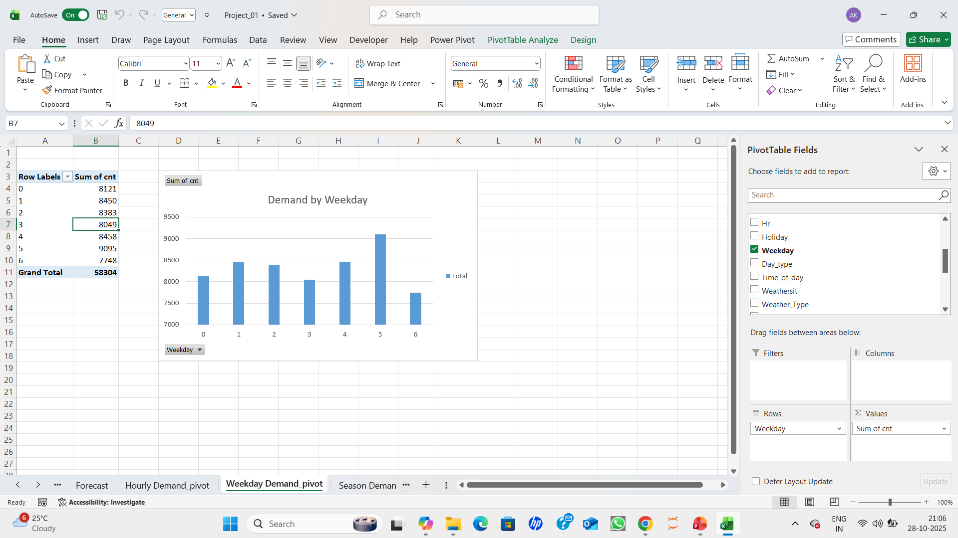
Step 6: Impact of Weather on Rentals: Go to insert > PivotTable Select the table as source Choose new worksheet named as “Weekday Demand”- click OK Drag Weekday to Rows. Drag cnt to Values.
Add a column chart to easy comparison of rental volume by day

Slide 14
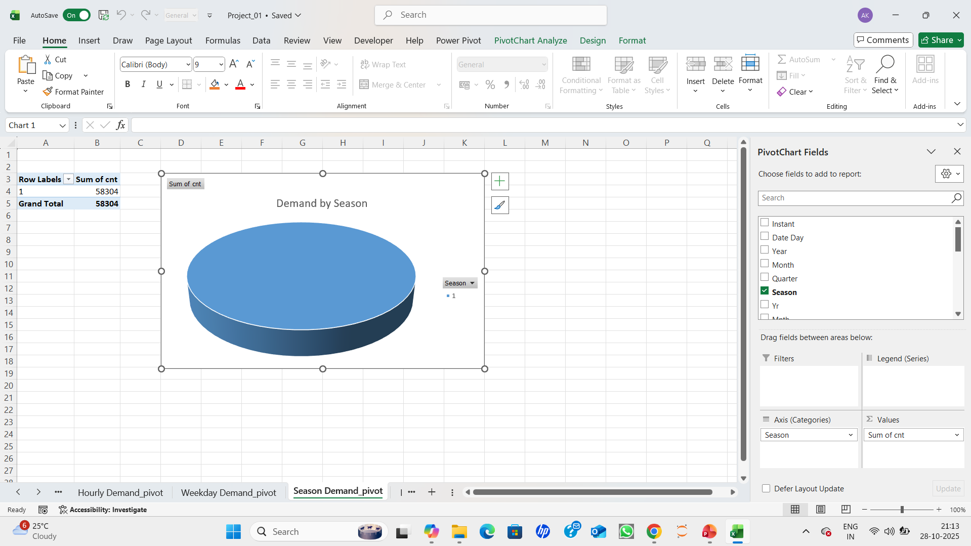
Step 7: Impact of Weather on Rentals: Go to insert > PivotTable Select the table as source Choose new worksheet named as “Season Demand”- click OK Drag Season to Rows. Drag cnt to Values.
Add a pie chart to highlights seasonal distribution

Slide 15
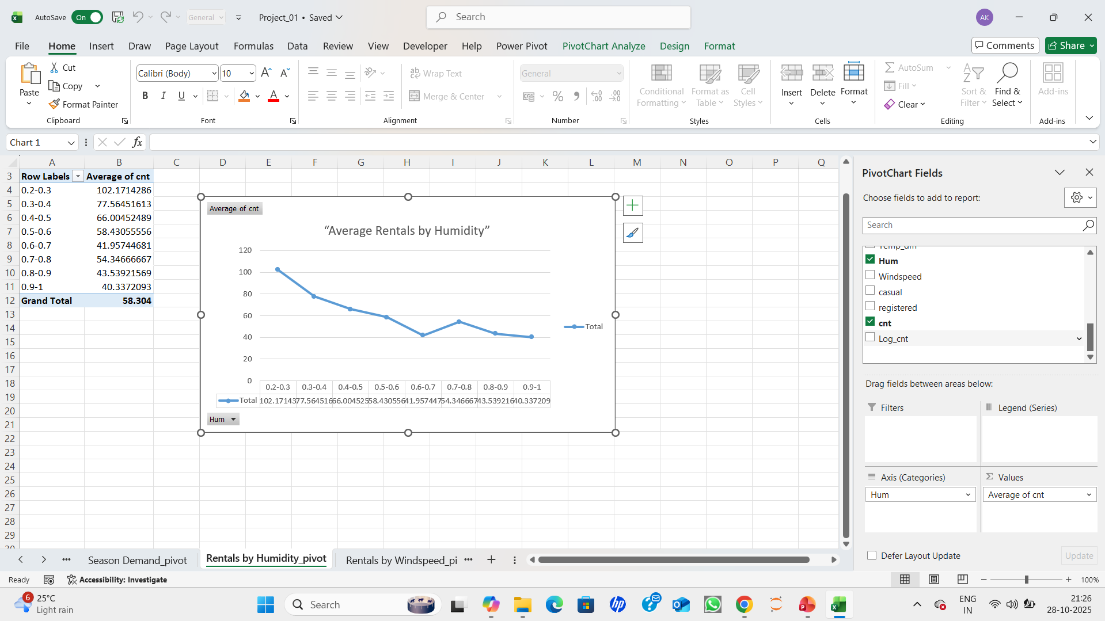
Step 8: Impact of Weather on Rentals: Go to insert > PivotTable Select the table as source Choose new worksheet named as “Average Rentals by Humidity” - click OK Drag Hum to Rows. Drag Average of cnt to Values.
Add a Line chart to shows how rentals change with weather variables

Slide 16
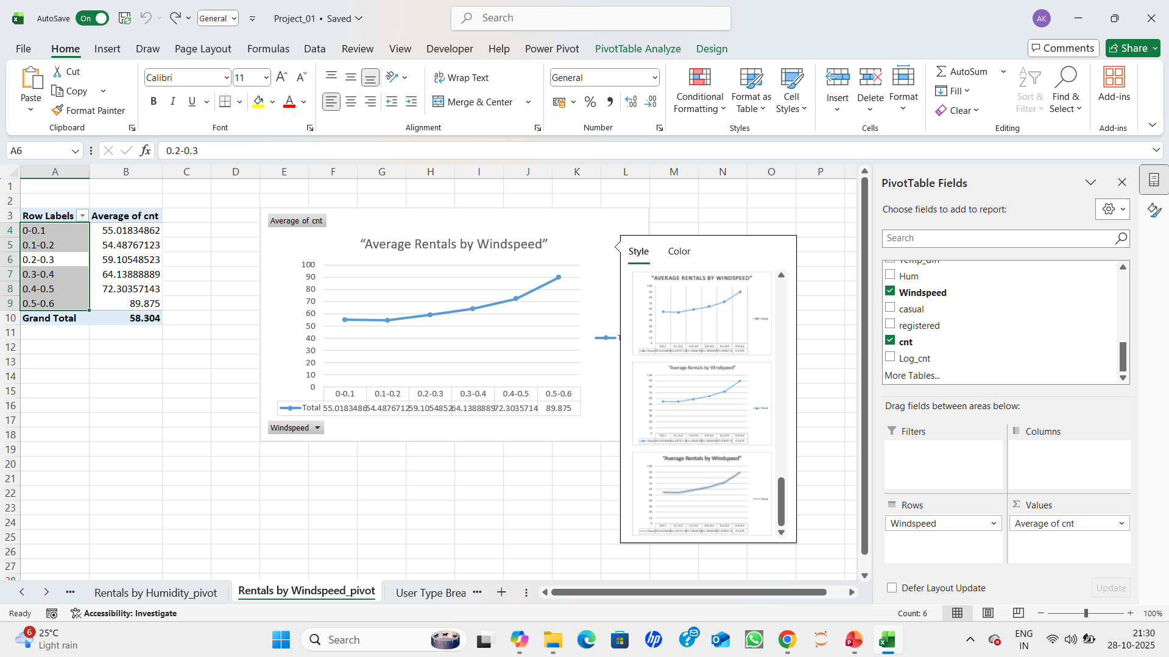
Step 9: Impact of Weather on Rentals: Go to insert > PivotTable Select the table as source Choose new worksheet named as “Average Rentals by Windspeed” - click OK Drag Windspeed to Rows. Drag Average of cnt to Values.
Add a Line chart to shows how rentals change with weather variables

Slide 17
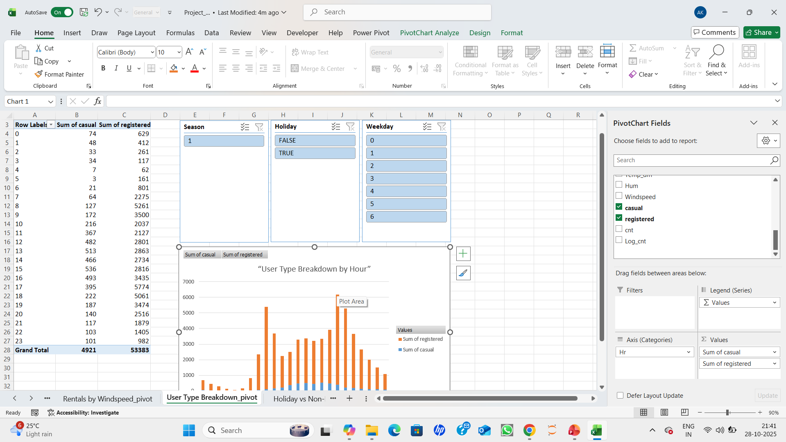
Step 10: Impact of Weather on Rentals: Go to insert > PivotTable Select the table as source Choose new worksheet named as “User Type Breakdown by Hour” - click OK Drag Hr to Rows. Drag sum of casual and sum of registered to Values.
Add a stacked column chart to compares casual vs registered users' side by side

Slide 18
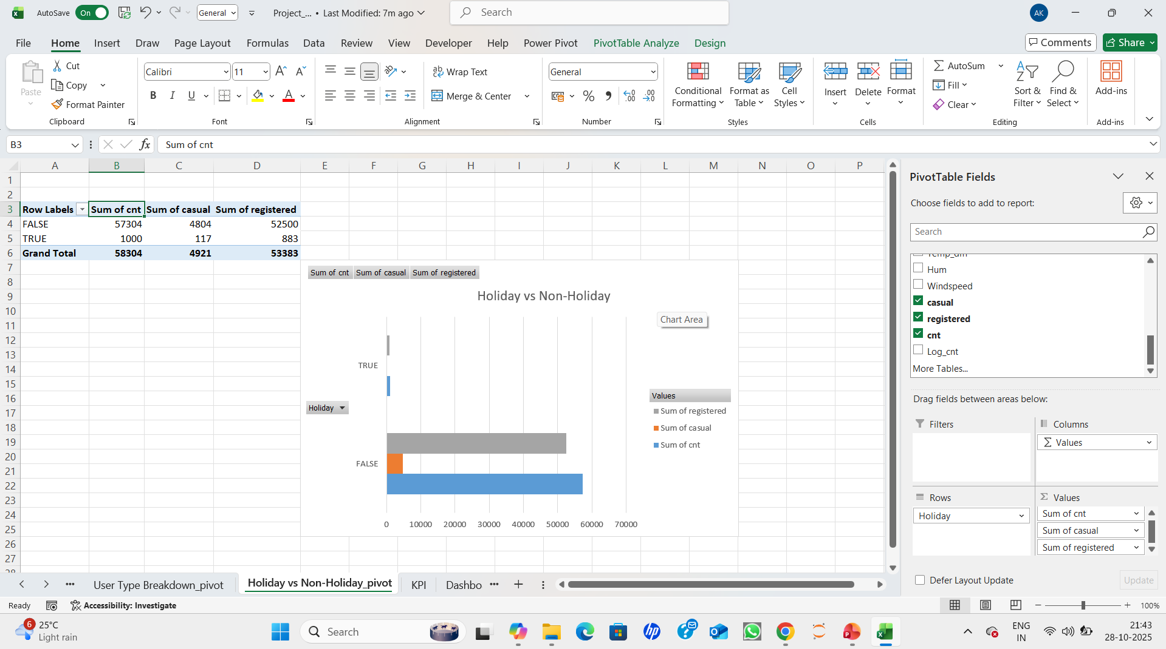
Step 11: Impact of Weather on Rentals: Go to insert > PivotTable Select the table as source Choose new worksheet named as “Holiday vs Non-Holiday”- click OK Drag Holiday to Rows. Drag sum of cnt, sum of casual and sum of registered to Values.
Add a clustered bar chart to contrasts demand across holiday status

Slide 19
Step 12: Impact of Weather on Rentals: Go to insert > PivotTable Select the table as source Choose new worksheet named as “Holiday vs Non-Holiday”- click OK Drag Holiday to Rows. Drag sum of cnt, sum of casual and sum of registered to Values.
Add a clustered bar chart to contrasts demand across holiday status

Slide 20
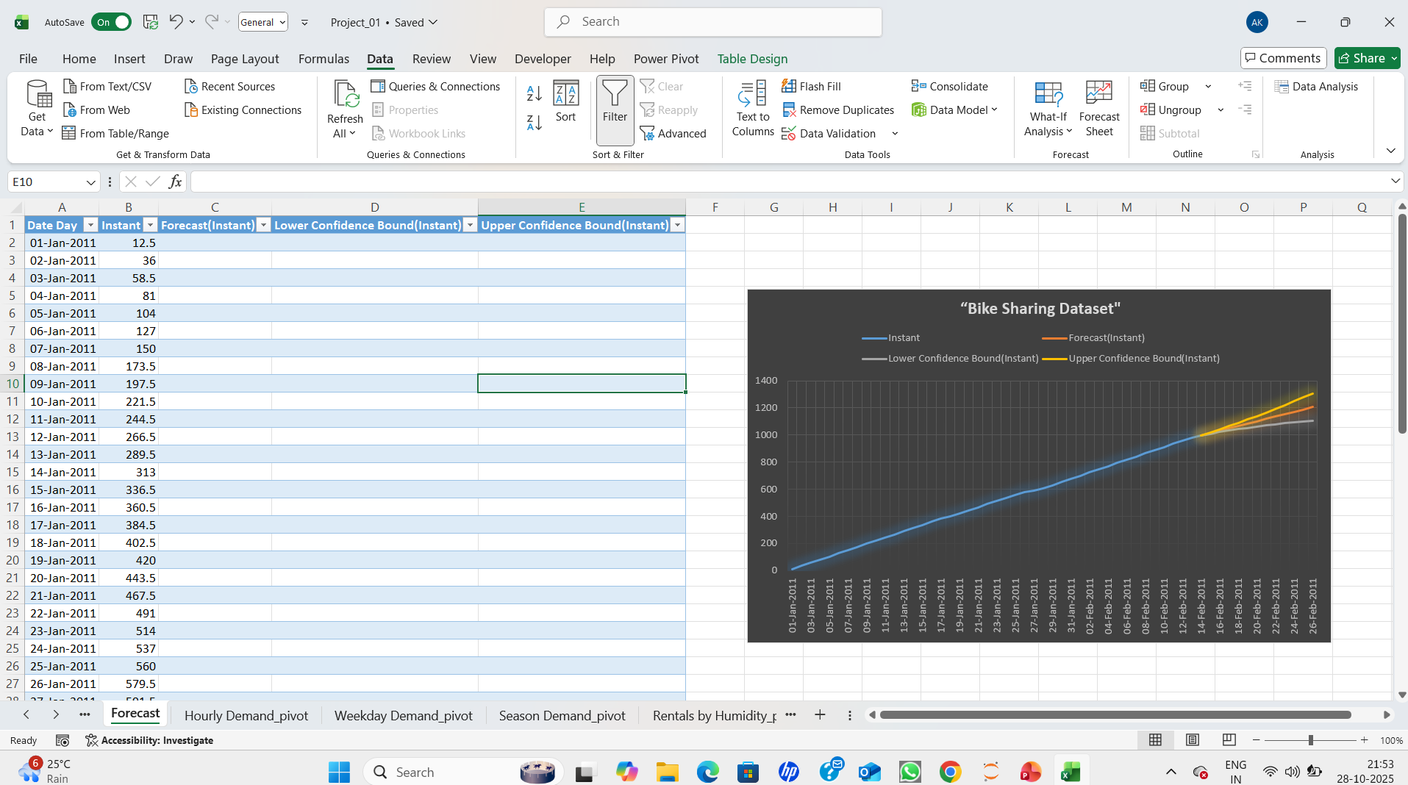
Step 13: We add a Forecast

Slide 21
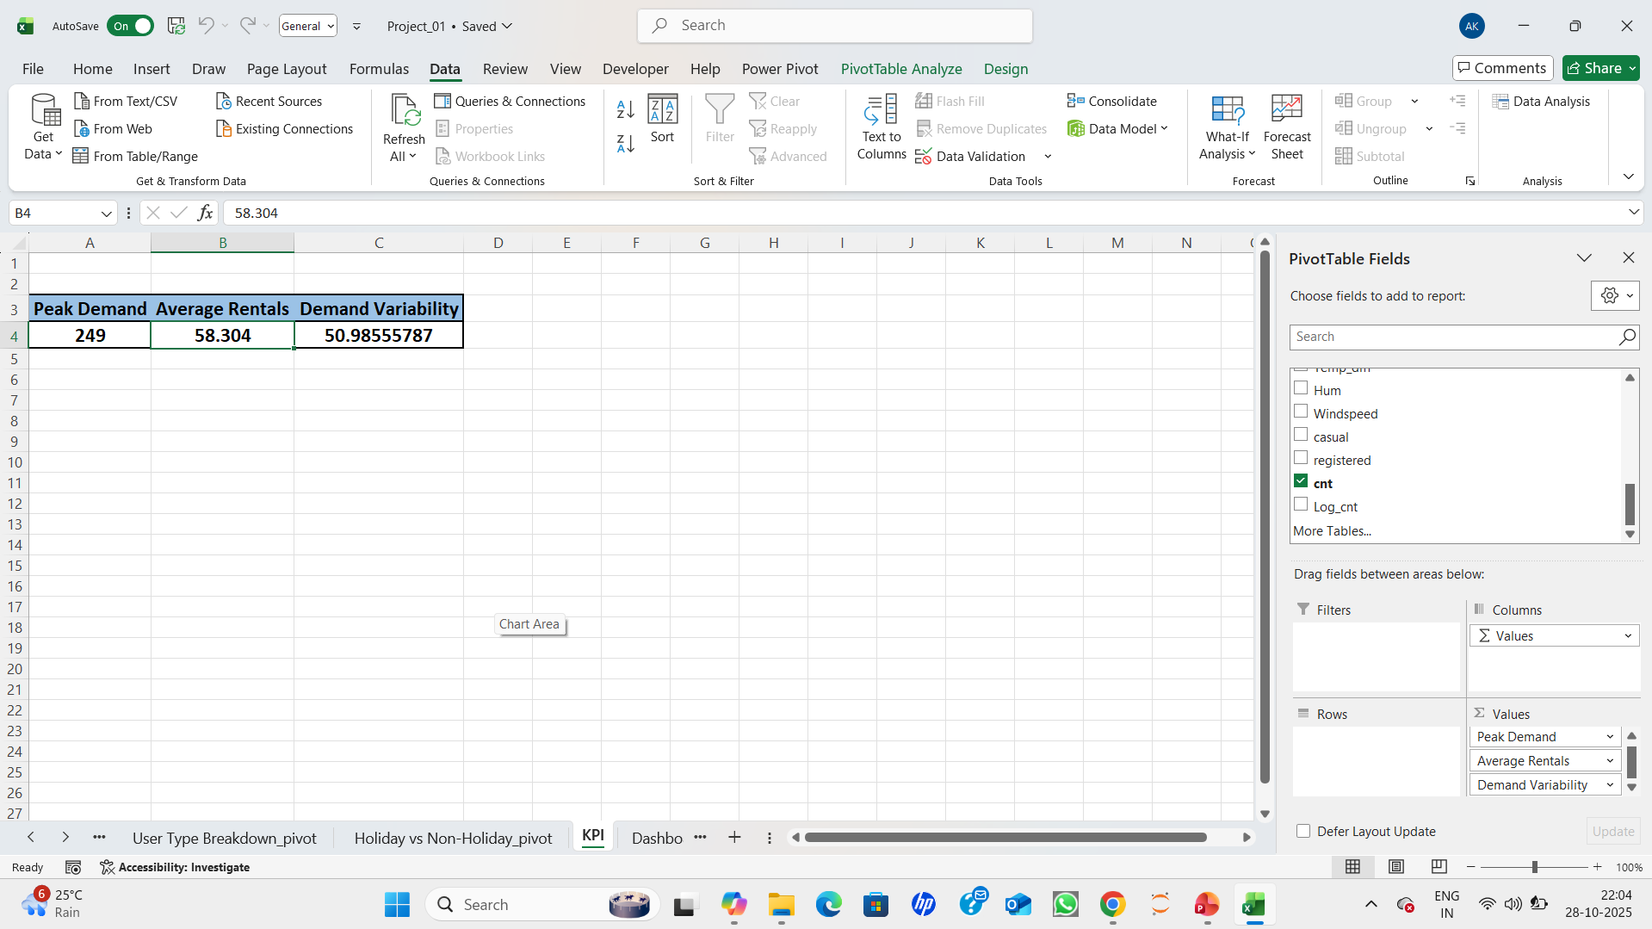
Step 14: create KPI Go to insert > PivotTable Select the table as source Choose new worksheet named as “KPI”- click OK Drag max of cnt, average of cnt and stdev of cnt to Values.
=MAX(cnt) → Peak Demand
=AVERAGE(cnt) → Average Rentals
=STDEV(cnt) → Demand Variability

Slide 22
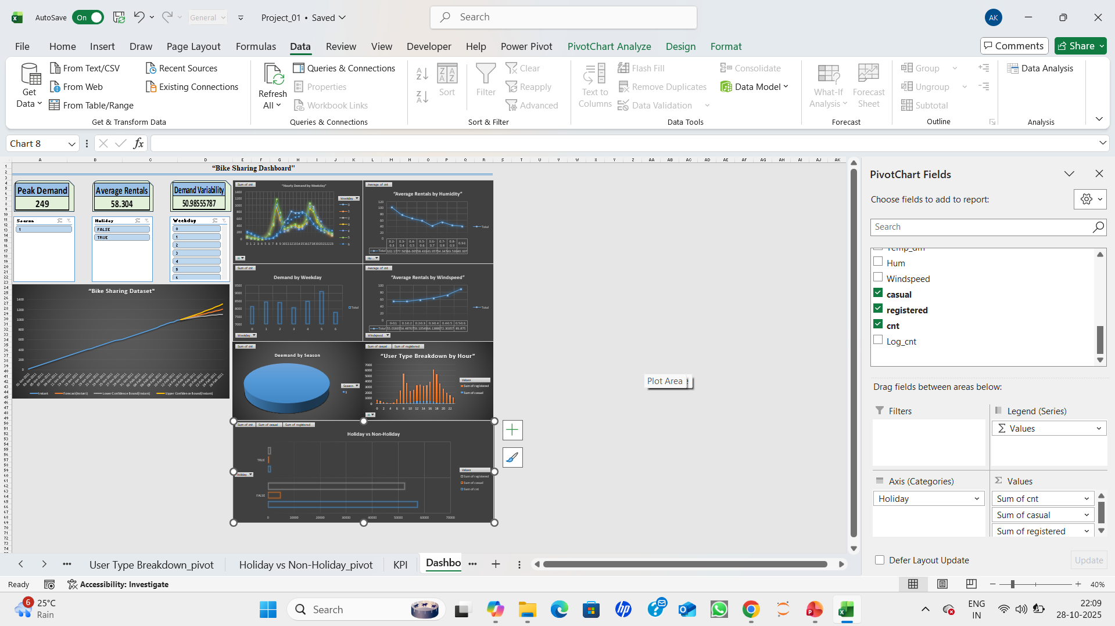
Step 15: After this we will start making dashboard by using all the pivot charts adding slicer and timeline

Slide 23
SUMMARY:
Excel is used in the Bike Sharing Demand Analysis project to investigate rental trends. It is evident from KPIs, PivotTables, and an interactive dashboard that the demand for bikes is greatest in the summer and lowest in the winter. Rainy days result in a large decrease in rentals, while clear weather stimulates more rides. Commuter peaks occur between 8 AM and 6 PM, according to hourly averages, and most rides are taken by registered users. All things considered, the dashboard offers lucid, data-driven insights to comprehend and prepare for demands for bike sharing that vary according to the seasons and the weather.

Slide 24


